Slide 1

#LifeKoKaroLift
Post-Graduate Diploma in ML/AI

Slide 2


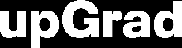
Course : Machine Learning
Lecture On : Boosting - Part 1
Instructor : Manish Kumar

Slide 3
Modules Included
Ensemble methods
Bagging
Boosting
Ada-Boost

Slide 4
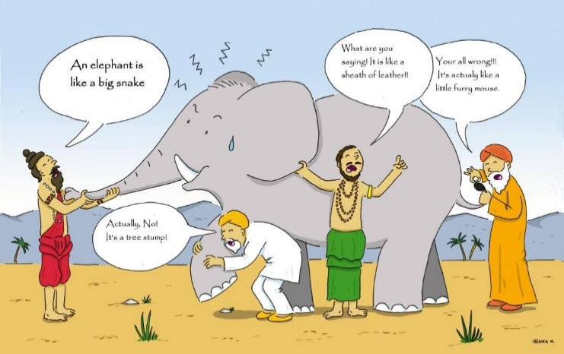
Ensemble methods
Ensemble learning is a machine learning paradigm where multiple models are trained to solve the same problem and combined to get better results.
sequential ensemble methods where the base learners are generated sequentially (e.g. AdaBoost). The basic motivation of sequential methods is to exploit the dependence between the base learners. The overall performance can be boosted by weighing previously mislabeled examples with higher weight.
parallel ensemble methods where the base learners are generated in parallel (e.g. Random Forest). The basic motivation of parallel methods is to exploit independence between the base learners since the error can be reduced dramatically by averaging.

Slide 5
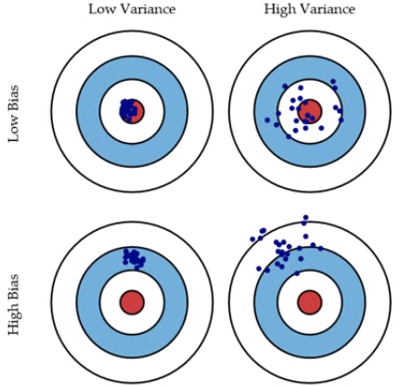
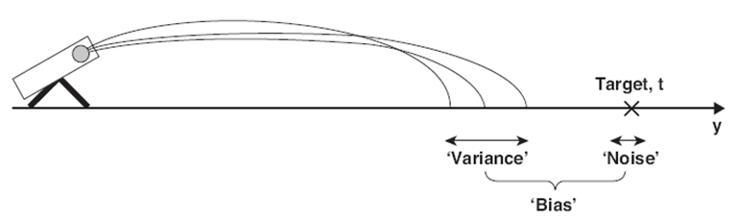
Bias and Variance in regression models
The prediction error for any machine learning algorithm can be broken down into three parts:
Bias Error
Variance Error
Irreducible Error
The irreducible error cannot be reduced regardless of what algorithm is used. It is the error introduced from the chosen framing of the problem and may be caused by factors like unknown variables that influence the mapping of the input variables to the output variable.

Slide 6
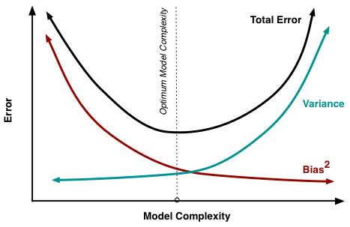
Bias-Variance Trade-Off
The goal of any supervised machine learning algorithm is to achieve low bias and low variance. In turn the algorithm should achieve good prediction performance.
Parametric or linear machine learning algorithms often have a high bias but a low variance.
Non-parametric or non-linear machine learning algorithms often have a low bias but a high variance.
The parameterization of machine learning algorithms is often a battle to balance out bias and variance.

Slide 7
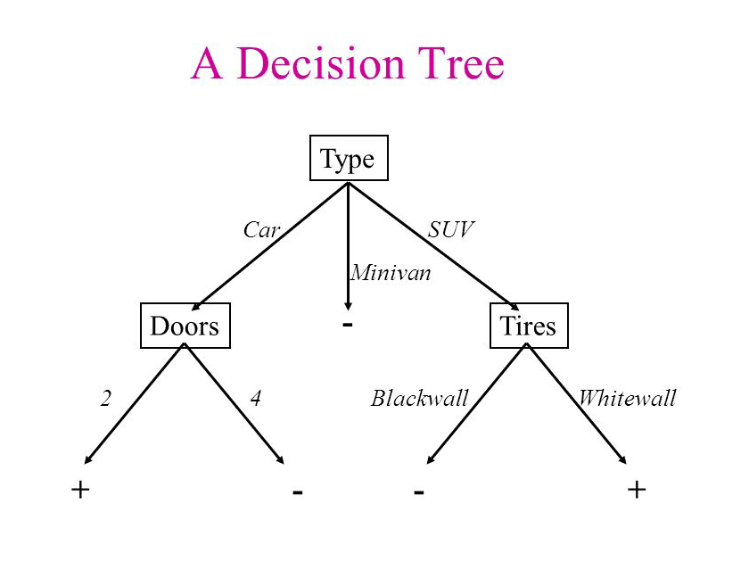
Decision Tree
Decision tree is the most powerful and popular tool for classification and prediction. A Decision tree is a flowchart like tree structure, where each internal node denotes a test on an attribute, each branch represents an outcome of the test, and each leaf node (terminal node) holds a class label.

Slide 8
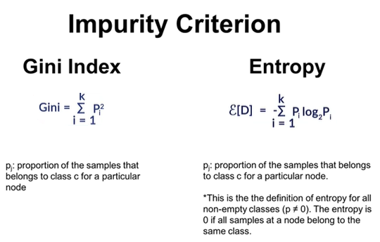
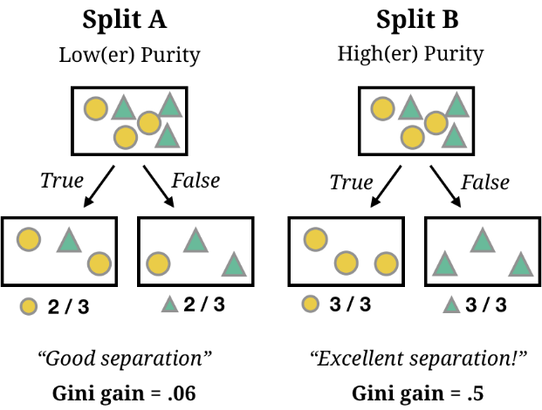
where to split ?

Slide 9



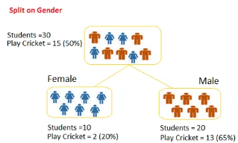

Poll 4
Question: we want to segregate the students based on target variable (playing cricket or not).we split the population using input variables Gender find the homogeneity of sub-nodes using Gini.
0.51
0.59
0.33
0.49
Practice in teams of 4 students
Industry expert mentoring to learn better
Get personalised feedback for improvements
09-05-2021
11

Slide 10
Poll 4 (Solution)
Question: we want to segregate the students based on target variable (playing cricket or not).we split the population using input variables Gender find the homogeneity of sub-nodes using Gini.
0.51
0.59
0.33
0.49
Practice in teams of 4 students
Industry expert mentoring to learn better
Get personalised feedback for improvements
Calculate, Gini for sub-node Female = (0.2)*(0.2)+(0.8)*(0.8)=0.68
Gini for sub-node Male = (0.65)*(0.65)+(0.35)*(0.35)=0.55
Calculate weighted Gini for Split Gender = (10/30)*0.68+(20/30)*0.55 = 0.59
09-05-2021
11

Slide 11
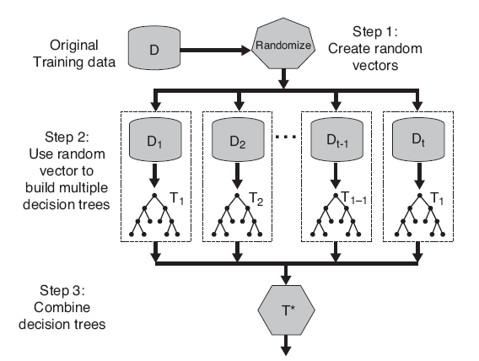
Random Forest
Bagging (Bootstrap Aggregation)
Decision trees are very sensitive to the data they are trained on.
small changes to the training set can result in significantly different tree structures.
Random forest takes advantage of this by allowing each individual tree to randomly sample from the dataset with replacement, resulting in different trees.
Feature Randomness — In a normal decision tree, while splitting a node, we consider all the features and pick the one that produces the most separation. In contrast, each tree in a random forest can pick only from a random subset of features. This forces even more variation amongst the trees in the model and ultimately results in lower correlation across trees and more diversification.

Slide 12
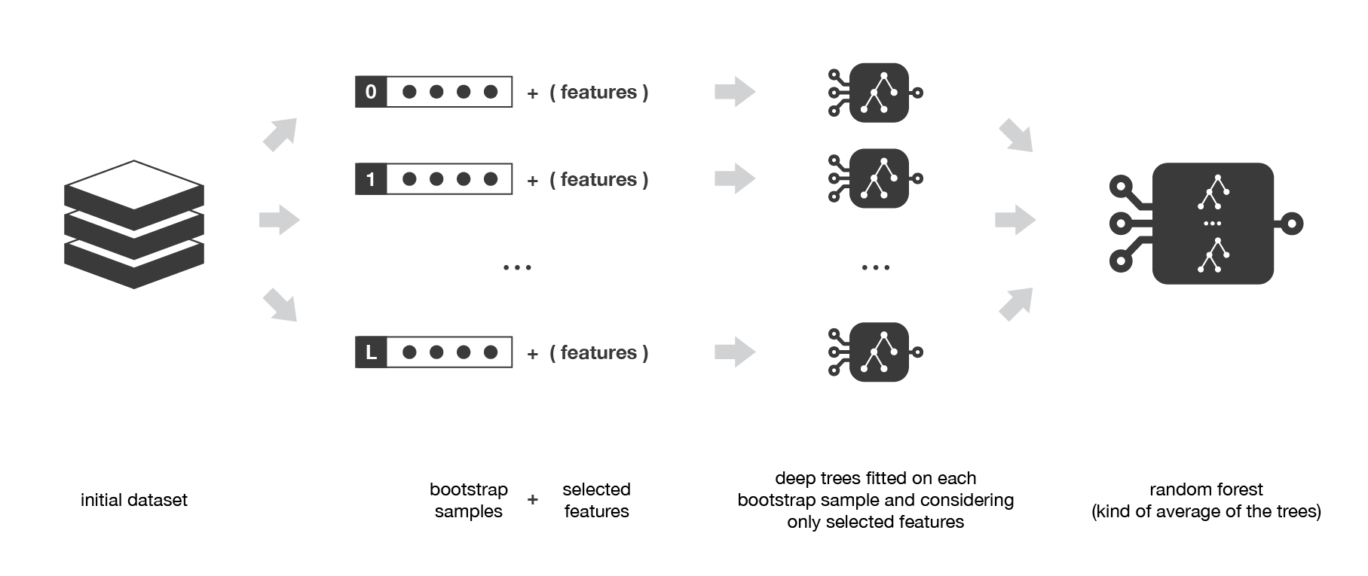
Random Forest

Slide 13
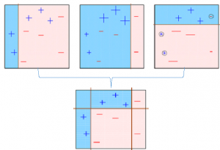
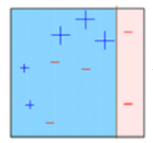
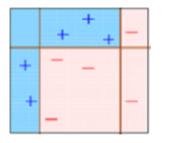
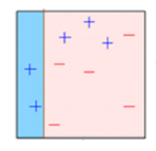
Boosting
The observations which are incorrectly predicted, are given higher weights and an another model is created and predictions are made on the dataset
Base model is created on a subset
. The individual models would not perform well on the entire dataset, but they work well for some part of the dataset. Thus, each model actually boosts the performance of the ensemble.
multiple models are created, each correcting the errors of the previous model.
The final model (strong learner)
Boosting, that often considers homogeneous weak learners, learns them sequentially in a very adaptive way (a base model depends on the previous ones) and combines them following a deterministic strategy

Slide 14
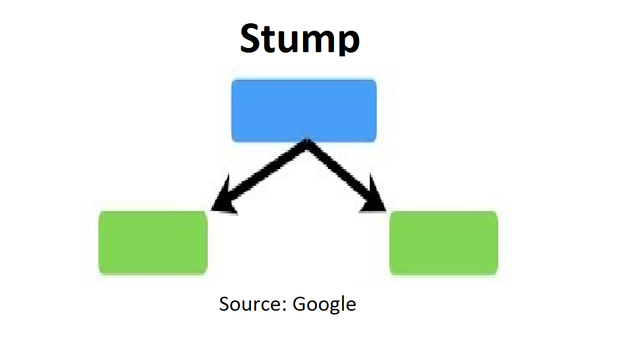
Boosting
Being mainly focused at reducing bias, the base models that are often considered for boosting are models with low variance but high bias. For example, if we want to use trees as our base models, we will choose most of the time shallow decision trees with only a few depths.

Slide 15
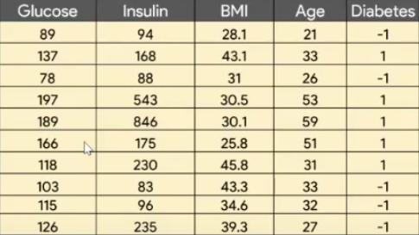
Ada Boost
Problem Statement : to predict whether or not a patient has diabetes based on the given features

Slide 16
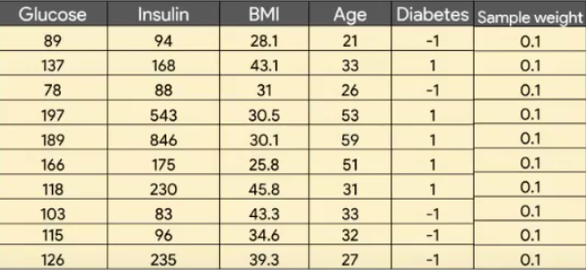
Ada Boost
Sample Weight = 1/10 =0.1
Step 1 Initialize the sample weights
At the beginning, each sample is associated with a weight that indicates how important it is with regards to the classification

Slide 17
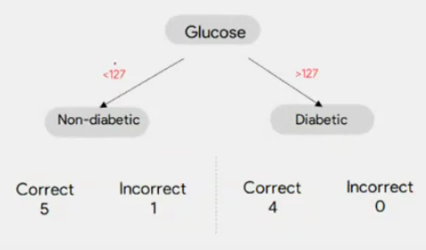
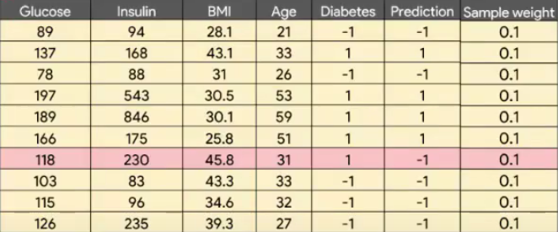
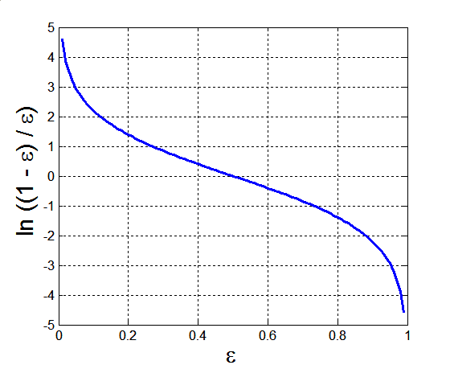
Ada Boost
The lower a classifier error rate, the more accurate it is, and therefore, the higher its weight for voting should be
Weight of a classifier C_{i}’s vote is
Error rate:
(i = index of classifier, j=index of instance)

Slide 18
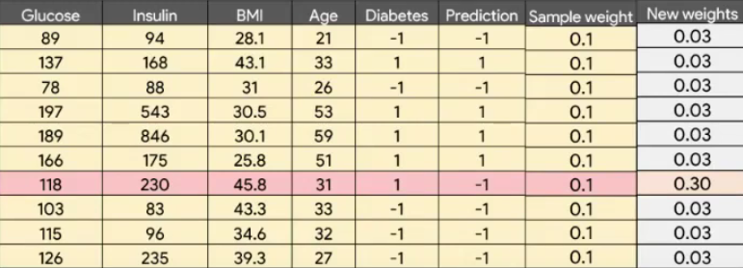
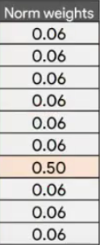
Ada Boost

Slide 19
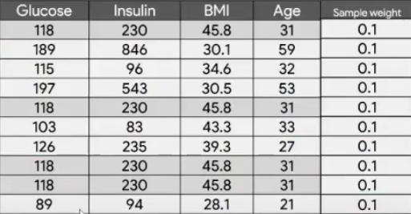
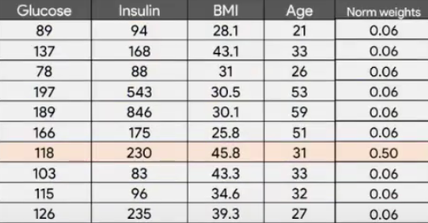
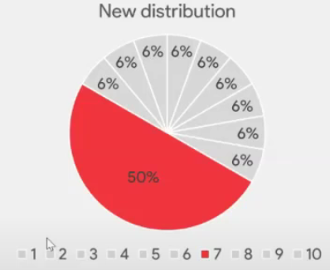
Ada Boost

Slide 20
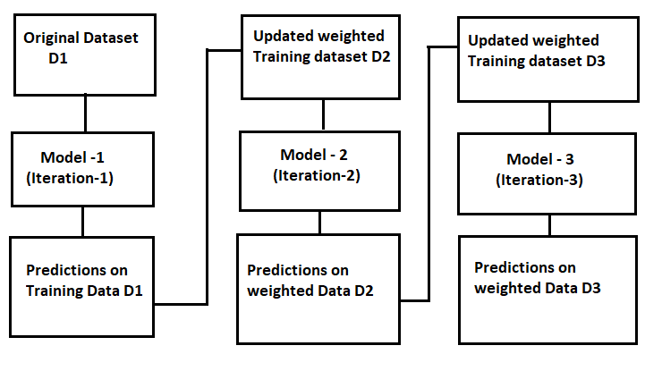
Ada Boost

Slide 21
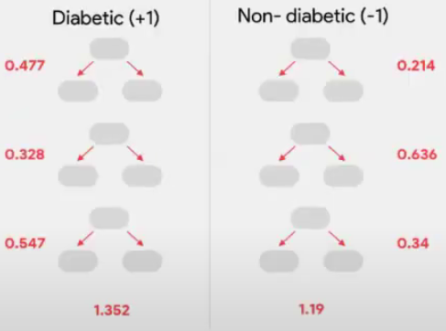
Ada Boost
Testing:
For each class c, sum the weights of each classifier that assigned class c to X (unseen data)
The class with the highest sum is the WINNER!

Slide 22
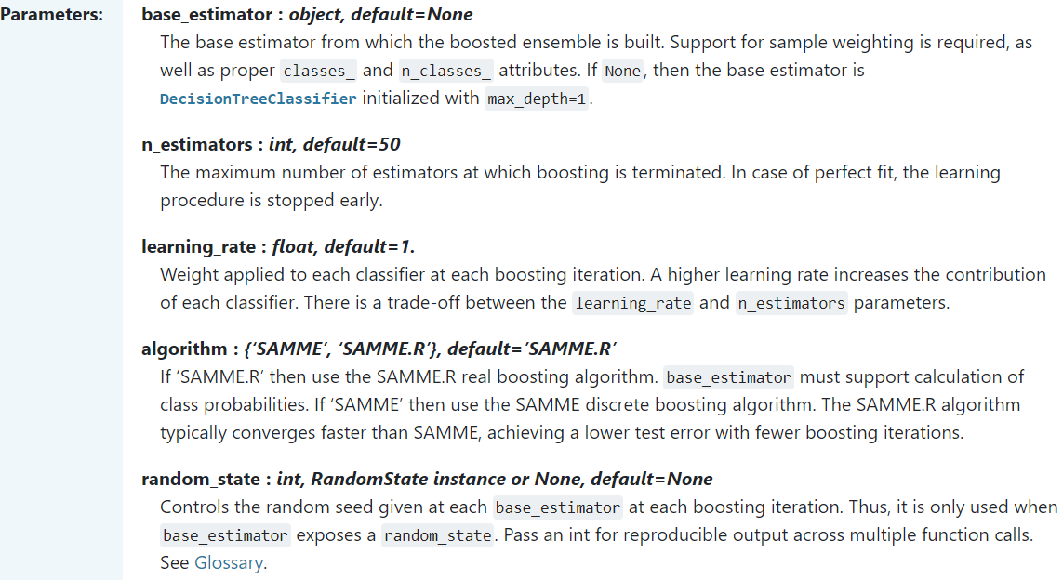
Ada Boost
https://scikit-learn.org/stable/modules/generated/sklearn.ensemble.AdaBoostClassifier.html

Slide 23

#LifeKoKaroLift
Thank You!

